Slide 1
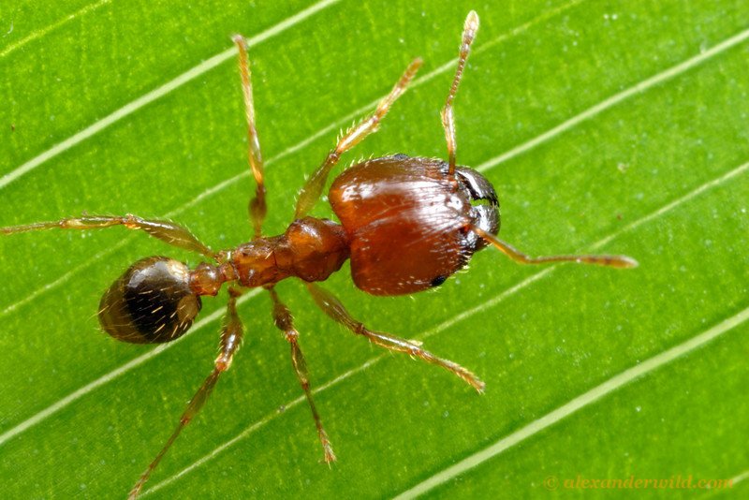
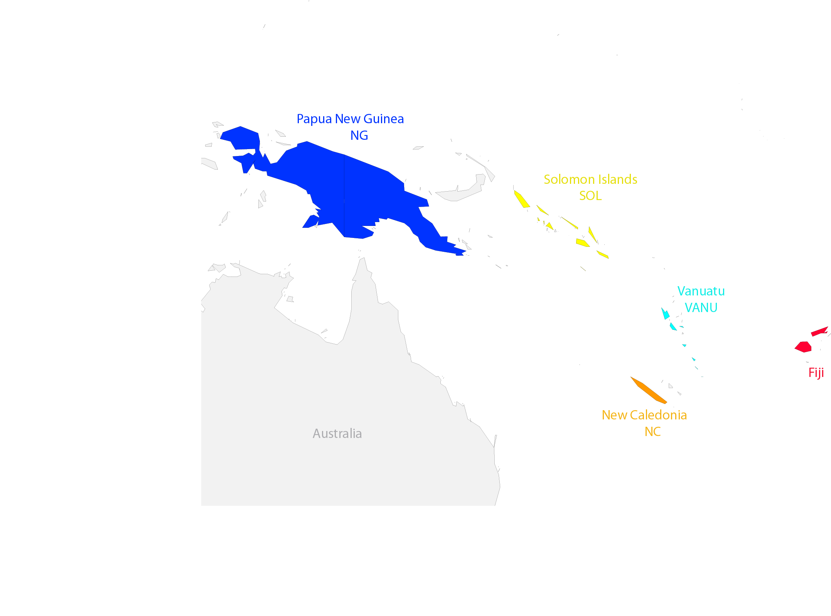
Colonization history and speciation dynamics: understanding species diversity patterns in the hyperdiverse Pheidole ants from the South Pacific
Pavel B Klimov¹, Evan Economo², L. Lacey Knowles¹.
¹University of Michigan; ²Okinawa Institute of Science and Technology
June 22, 2013, Evolution 2013, Snow Bird, Utah

Slide 2
Island Biogeography
The number of species on an island is an equilibrium between:
Immigration
In situ speciation
In situ extinction
[affected by island size]
[affected by distance]
[affected by island size]

Slide 3
Island Biogeography: Predictions
Distance from source (e.g., continent) | Predominant process
Small | Colonization
Large | In situ speciation
Island size | Species richness
Small | Low
Large | High

Slide 4
Island Biogeography
These basic ideas of Island Biogeography were developed by MacArthur and Wilson in the late sixties.
Only a few studies tested them quantitatively [using plants or vertebrates].
A recent paper argues that dispersal is not always asymmetrical, but also can be from island to continent¹.
¹ Filardi and Moyle (2005). Nature. 438: 216-219

Slide 5
Model System: Geography
Melanesian Pheidole ants is an excellent arthropod model for testing island biogeography hypotheses:
The region was the focal area for classical biogeographic studies in the past
New Guinea and Australia were connected during late Pleistocene = source area
Archipelagos were never connected by land bridges
Ant radiation probably occurred after the geological origin of the archipelagos
Ants are speciose and their fauna is [relatively] carefully surveyed
Never connected
n=145
n=15
785,753 km²
28,400 km²
Connected
(late Pleistocene)
n=7
12,190 km²
n=57
n=48
18,274 km²
18,576 km²

Slide 6
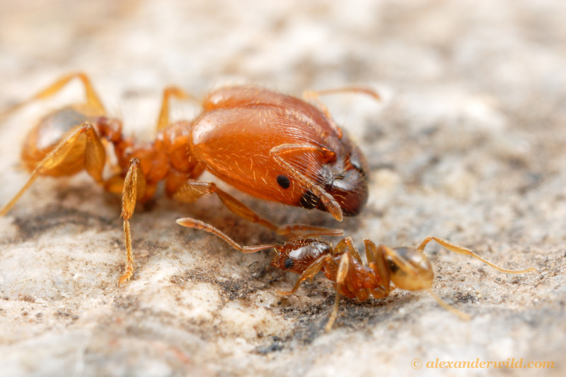
Model System: Pheidole
Eusocial (queen and workers)
Two types of workers
Feed on seeds or insects
~1100 spp worldwide
~272 spp in Melanesia
Many spp endemic
Some spp invasive and
widely distributed
Major and minor workers of Pheidole spadonia

Slide 7
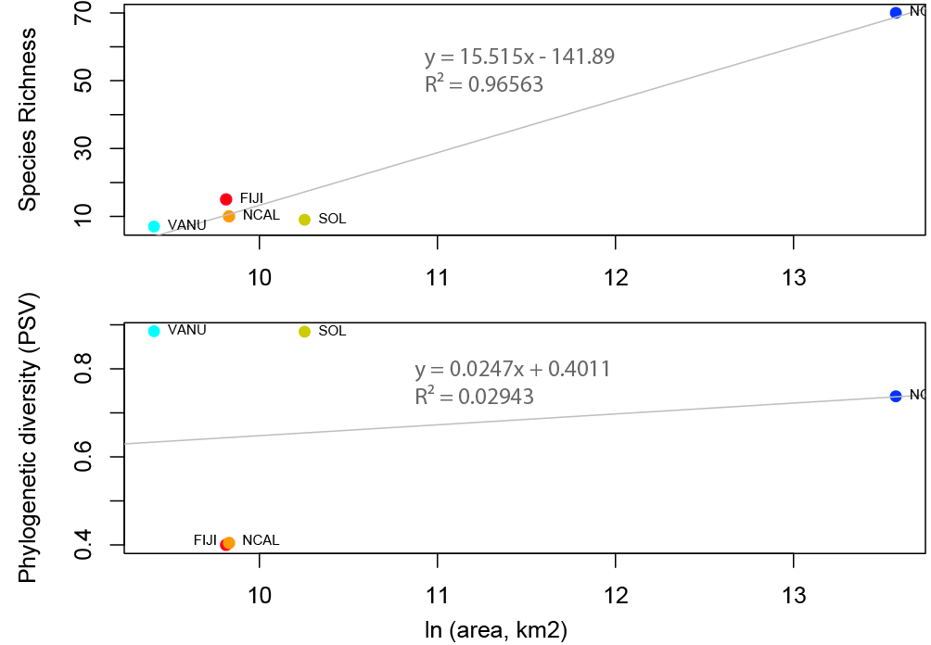
Island size
PSV=phylogenetic species variability.
Species richness increases with area size, but PSV may increase or decrease.
PSV proposed in Helmus et al., 2007. Am. Nat. 169: 68-83

Slide 8
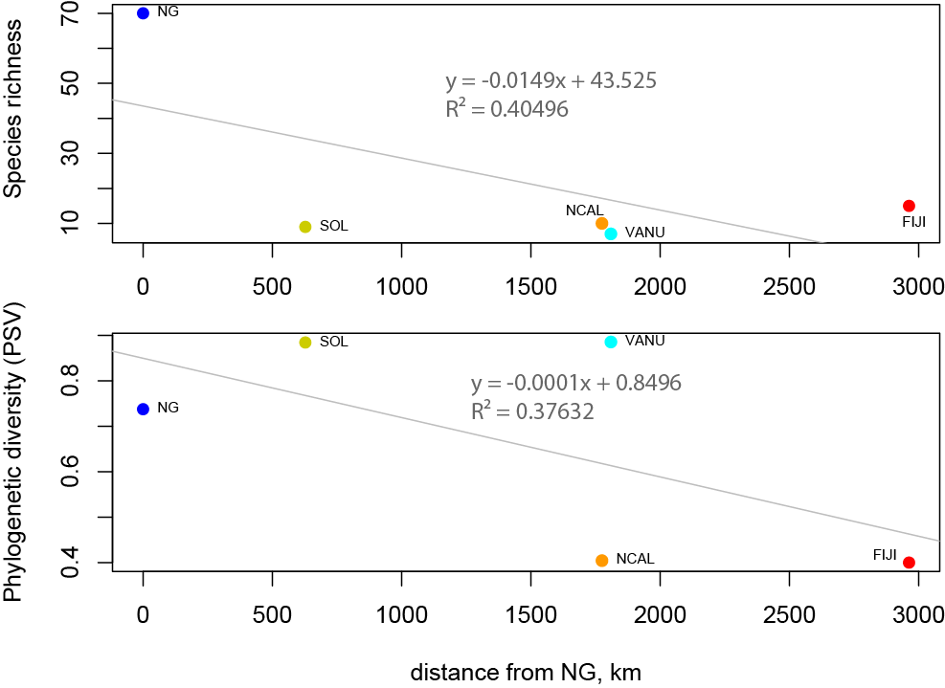
Distance from source area
Maximum Likelihood tree (RAxML). 311 taxa, 9 loci, 8913 nt (aligned), 25 partitions
With distance, species richness decreases, but PSV may decrease or increase

Slide 9
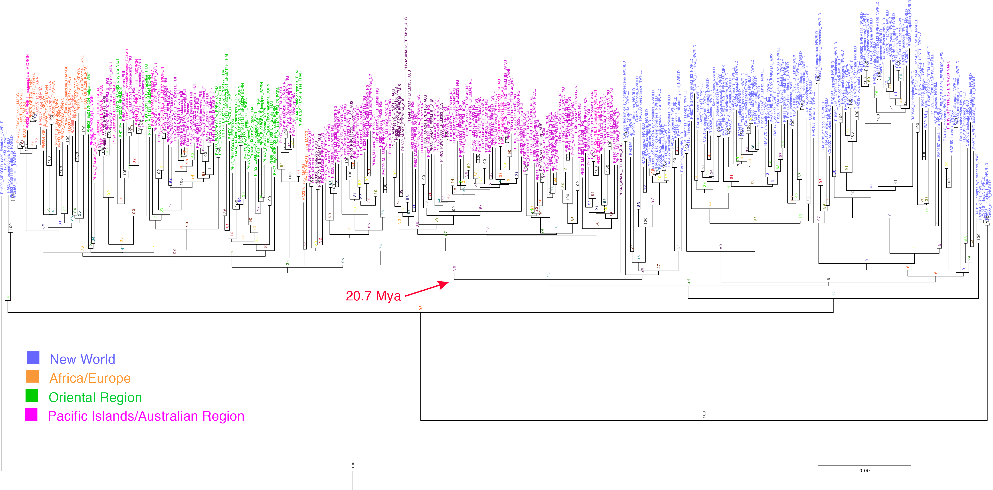
Global diversification of Pheidole
Maximum Likelihood tree (RAxML). 311 taxa, 9 loci, 8913 nt (aligned), 25 partitions
1 mt (CO1) and 8 nuclear genes. There are many pseudogenes for CO1; H3 has two-copies. Copy-specific protocols developed for CO1 and H3.

Slide 10
Global diversification of Pheidole
Single colonization of the Old World from the New World. ~ 20.7 Mya
Divergence time estimation: BEAST v1.7.5
Insect molecular clock

Slide 11
Global diversification of Pheidole
~ 20 Mya
Two major invasions into Australia/Pacific ~20 Mya
Melanesian archipelagoes already existed by this time

Slide 12
Historical biogeography of Pheidole in Melanesia
Asian ancestor
~20Mya
~15.4 Mya
African ancestor
Colonization of Fiji
Diversification
~13.3 Mya
Colonization of New Caledonia
Tree pruned to include only the target region

Slide 13
Historical biogeography of Pheidole in Melanesia
Asian ancestor
~20Mya
~15.4 Mya
African ancestor
Colonization of Fiji
Diversification
Pheidole line
~13.3 Mya
Colonization of New Caledonia
Tree pruned to include only the target region

Slide 14
Monarcha flycatchers
x
Monarcha line
Filardi and Moyle (2005). Nature. 438: 216-219

Slide 15
Historical biogeography of Pheidole in Melanesia
Asian ancestor
smaller clade
(31 spp on tree)
~20Mya
~15.4 Mya
African ancestor
Colonization of Fiji
Monarcha line
Diversification
larger clade
(80 spp on tree)
Pheidole line
~13.3 Mya
Colonization of New Caledonia
Tree pruned to include only the target region

Slide 16
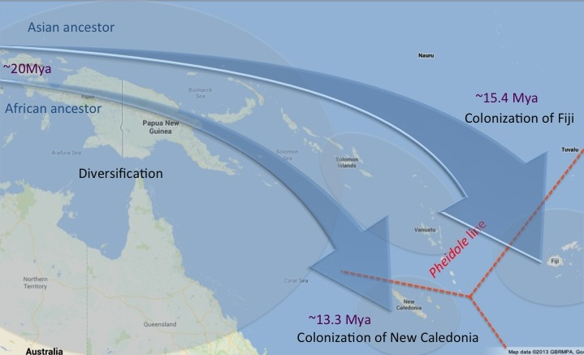
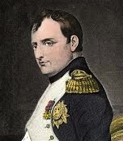
Is this scenario statistically supported?
Plan of conquering Europe in seven days
B. Napoléon
TOP SECRET
Our biogeographic model was evaluated in two programs:
Lagrange v2.0.1 (DEC model)
Diveristree
BioGeoBEARS (will be fully implemented soon)

Slide 17
Testing Biogeographic Hypotheses
Both Lagrange and Diveristree can estimate speciation, extinction, and dispersal rates given a phylogenetic tree
Models from these programs can be constrained to fit certain biogeographic scenarios (eg., unidirectional dispersal)
Constrained and unconstrained model then compared by LRT, AIC etc.
[affected by island size]
[affected by distance]
[affected by island size]

Slide 18
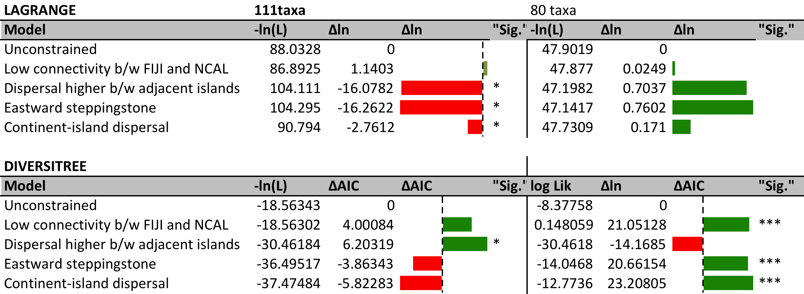
Testing Biogeographic Hypotheses
BioGeoBEARS: founder-effect more models
The DEC method, in emulating
the analysis of character evolution on a known phylogeny,
focuses attention on range inheritance scenarios at cladogenesis
events and adopts a somewhat more complex view of states
that allows for widespread taxa and flexible constraints on
ranges and dispersal.
Low connectivity between NCAL and FIJI is consistently supported.
80-taxon analyses yield consistent results in contrast to 111-taxon analyses.
Need to test BioGeoBEARS (will be fully implemented soon)

Slide 19
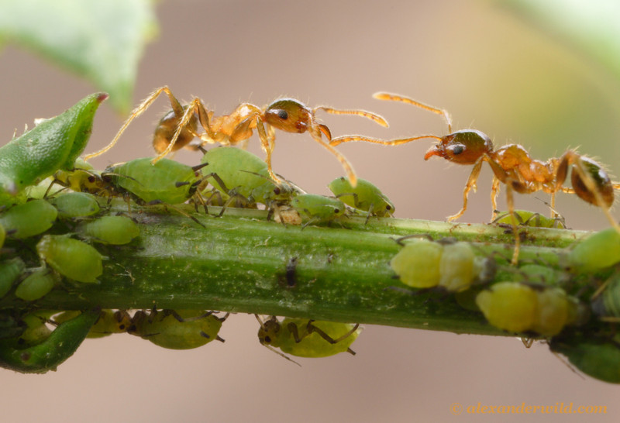
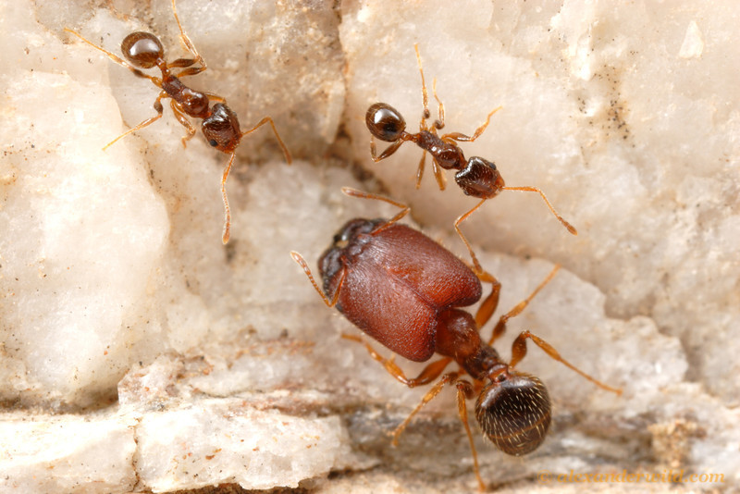
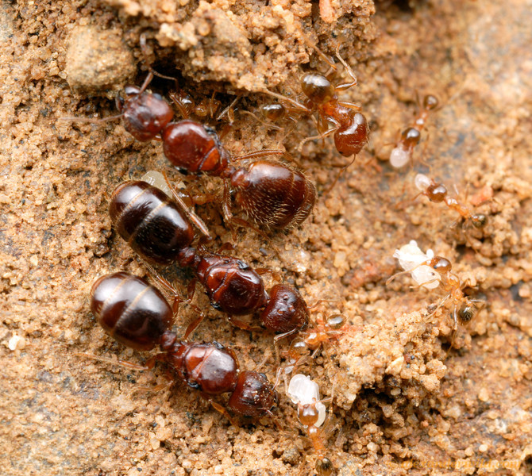
Acknowledgements
NSF
Knowles lab
Rich FitzJohn (Diveristree)
Nick Matzke (BioGeoBEARS)
Collaborators

