Slide 1
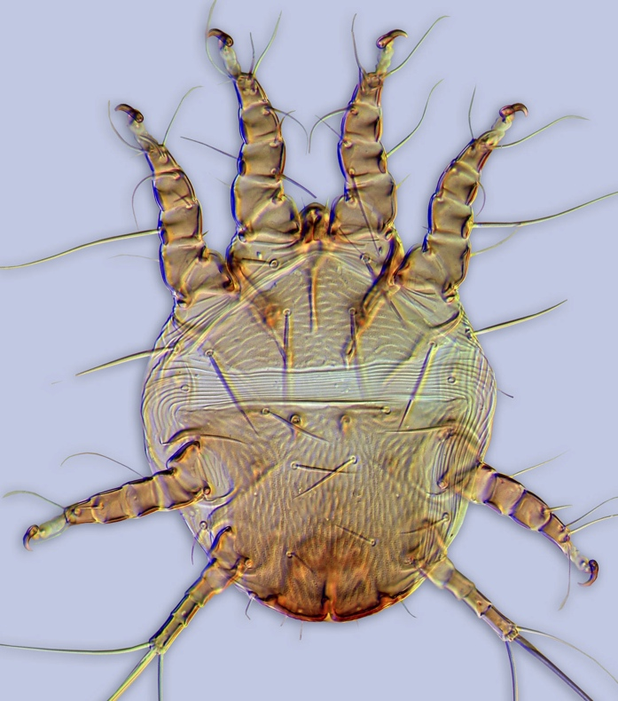
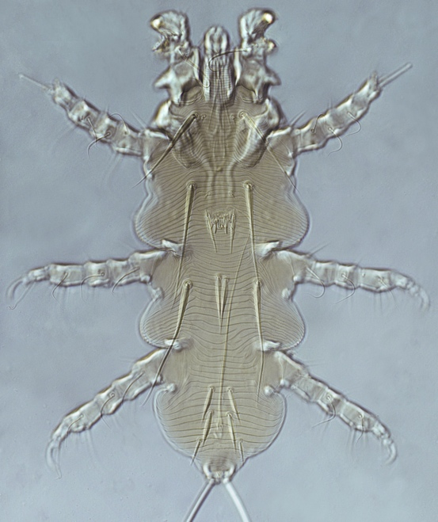
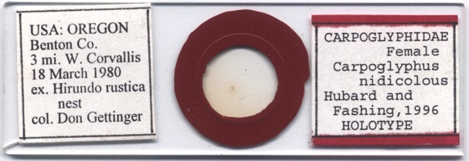
Slide imaging at University of Michigan
Museum of Zoology
Pavel B Klimov
University of Michigan
Sept 17, 2013 Fluid-Preserved Invertebrate and Microscopic Slide Imaging Workshop, Museum of Natural History
University of Michigan, Ann Arbor, MI

Slide 2
Museums and biodiversity
Microscopic organisms constitute a large proportion of biodiversity.
For example, Acari (mites and ticks) have an estimated 1 million species. Of them, only nearly 5% is described.
Most mites specimens can be identified and stored on microscopic slides.
Types and vouchers of Acari are kept in many museums around the world. They serve as reference for species identification and discovery.

Slide 3
Mites: relative sizes
xuy

Slide 4
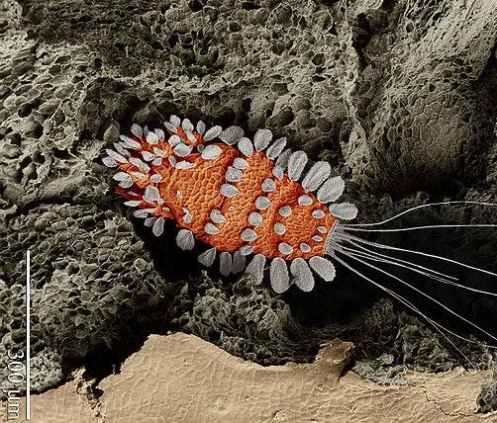
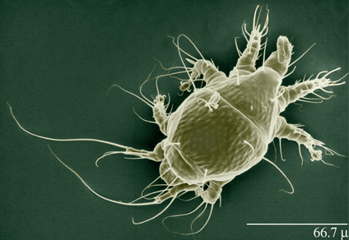
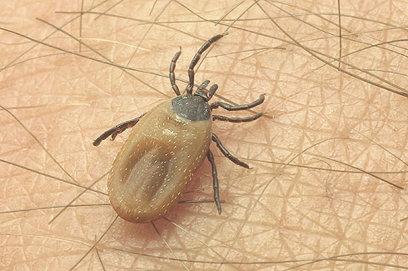
Mites
One of the earliest terrestrial animals (fossil record 410 Mya)
Important planetary ecosystem service (decomposers)
Economically important (agricultural & stored food pests, predatory mites are used for pest control)
Medically important (transmit diseases, cause allergies, parasites of humans and animals)
Models for testing evolutionary hypotheses (maintenance of long-term asexuality, coevolution with hosts)

Slide 5
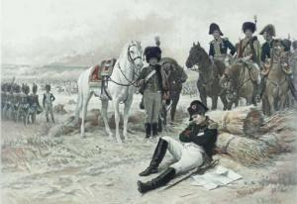
Diversity of Mites
Sir, our troops are surrounded by Cossacks
House dust mites
Feather mites
Spinose ear tick
Demodectic mites
Eyelash mite
Sarcoptic mange
mite
chorioptic mange mite
chiggers
No, mites did it first
Cheyletid mites
Gall mites
Straw itch mite
Spider mites
Stored product mites
False spider mites
wheat curl mite
Phytoseiid mites
winter grain mite
grain mites
Soil mites
Cheese mite

Slide 6
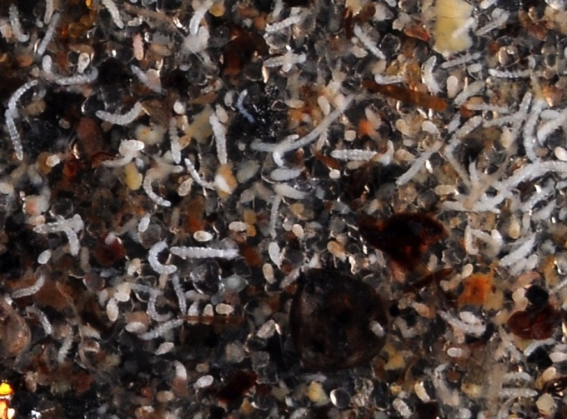
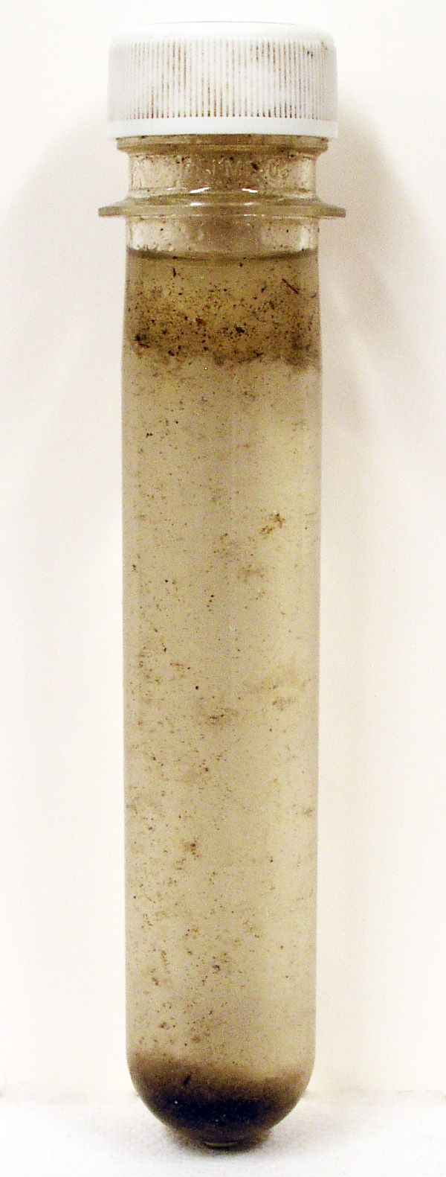
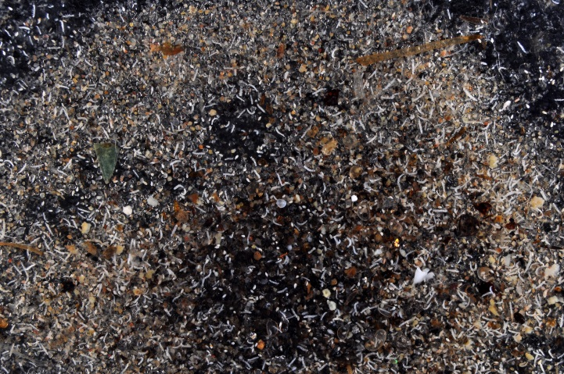
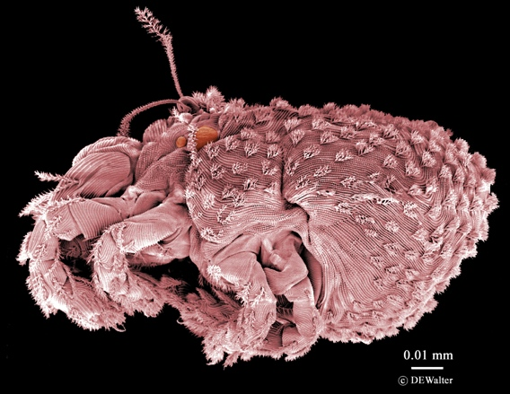
Soil mites
Kerosene
There are millions of mites in the soil where their primarily decompose various organic substances. This picture shows the entire sample of mites extracted from a half of a bucket of sandy soil in Michigan using Kerosene/Ethanol extraction.
75% Ethanol

Slide 7
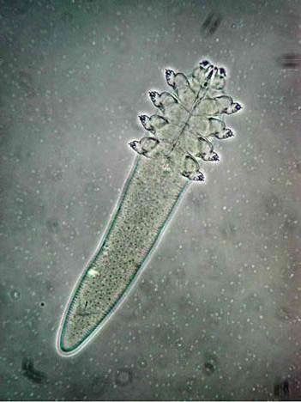

Demodex folliculotum
(eyelash mite)
Parasitic mites
Humans serve as natural hosts for Demodex folliculorum, or eyelash mite. The mite infestation appears to be nonpathogenic in most individuals. However, they may contribute to the inflammatory reaction by blocking pores, inducing allergic reaction, or by vectoring bacteria on the skin.

Slide 8
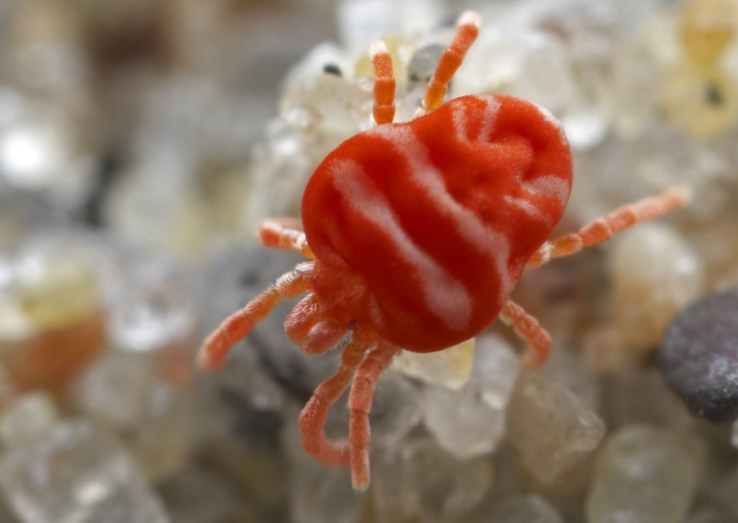
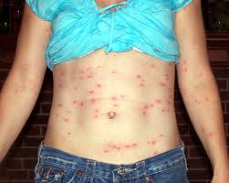
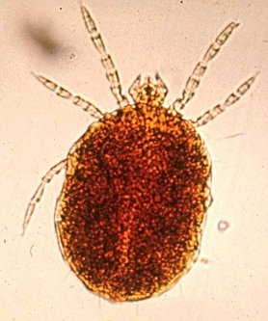
Parasitic mites
Adult and nymphs of chiggers are predators, but
larvae are typically parasites.
Chigger bites often result in a condition known as trombidiosis (or trombiculosis), which is' characterized by intensely itchy lesions in the skin that may become inflamed or infected. Some
chiggers act as vectors for diseases, the most important
being scrub typhus.
Trombicula autumnalis

Slide 9
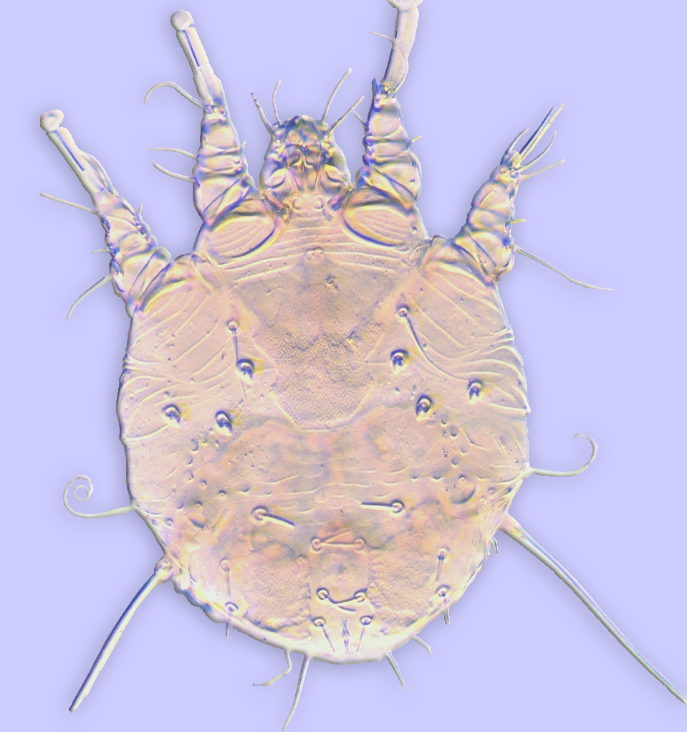
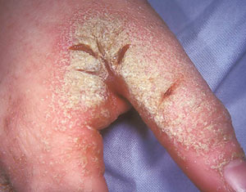
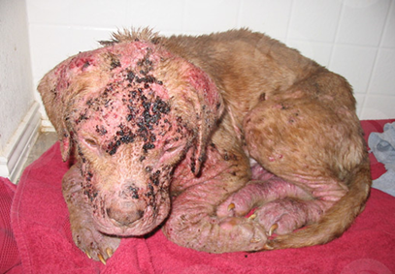
Parasitic mites
The human scbies mites burrow beneath the skin of their hosts and feed on subepidermal exudates. In humans this mite is relatively benign, but when it secondarily infects domesticated or wild animals it may disable or kill the host.
Sarcoptes scabiei (Sarcoptidae)
Sarcoptes scabiei (Sarcoptidae)

Slide 10

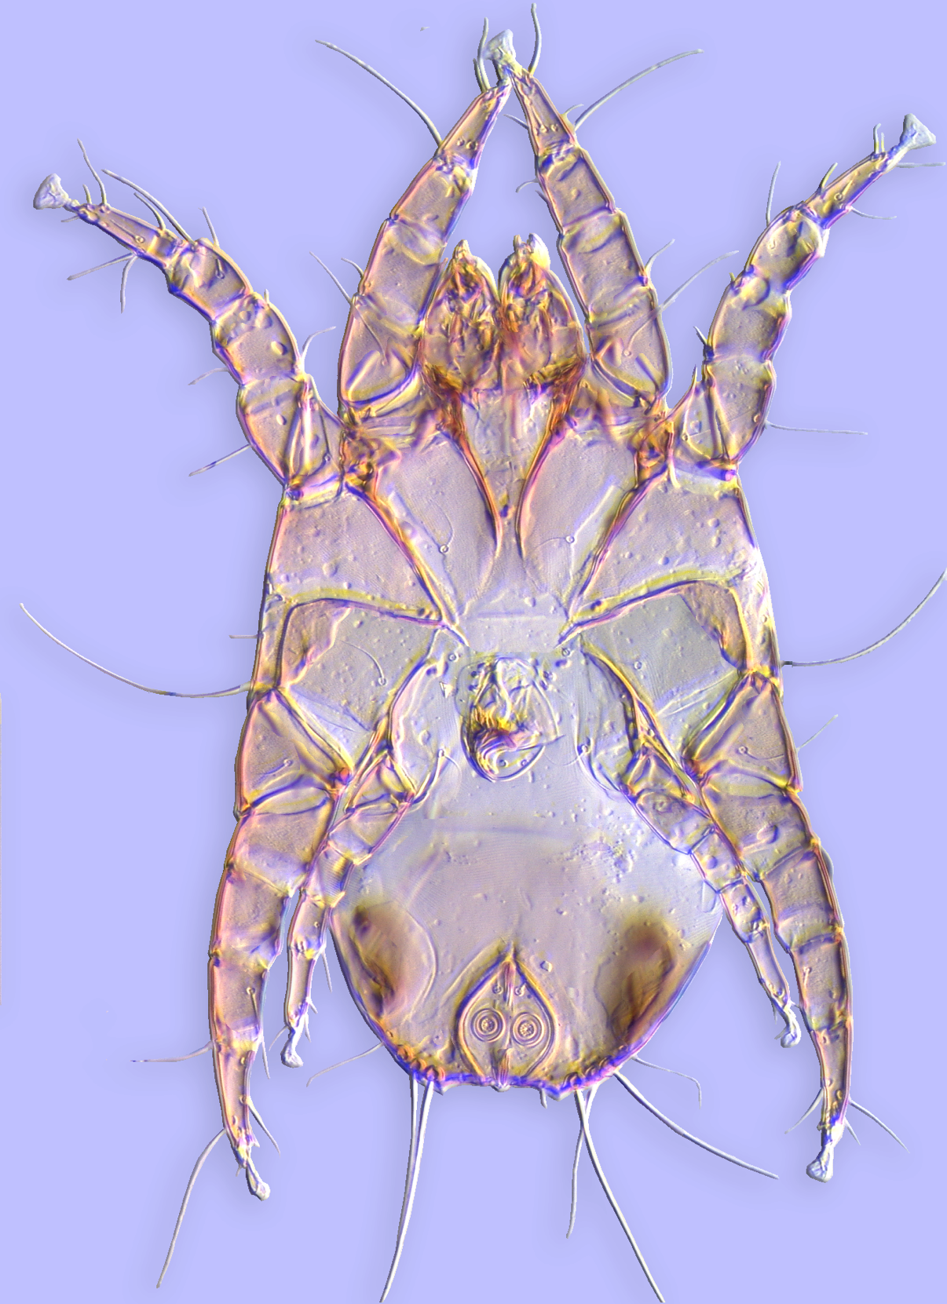
House dust mites
House dust mites cause allergies and respiratory diseases that affect 60 million to 1.2 billion people worldwide. .
Dermatophagoides farinae
Sarcoptes scabiei (Sarcoptidae)
Sturnophagoides bakeri

Slide 11

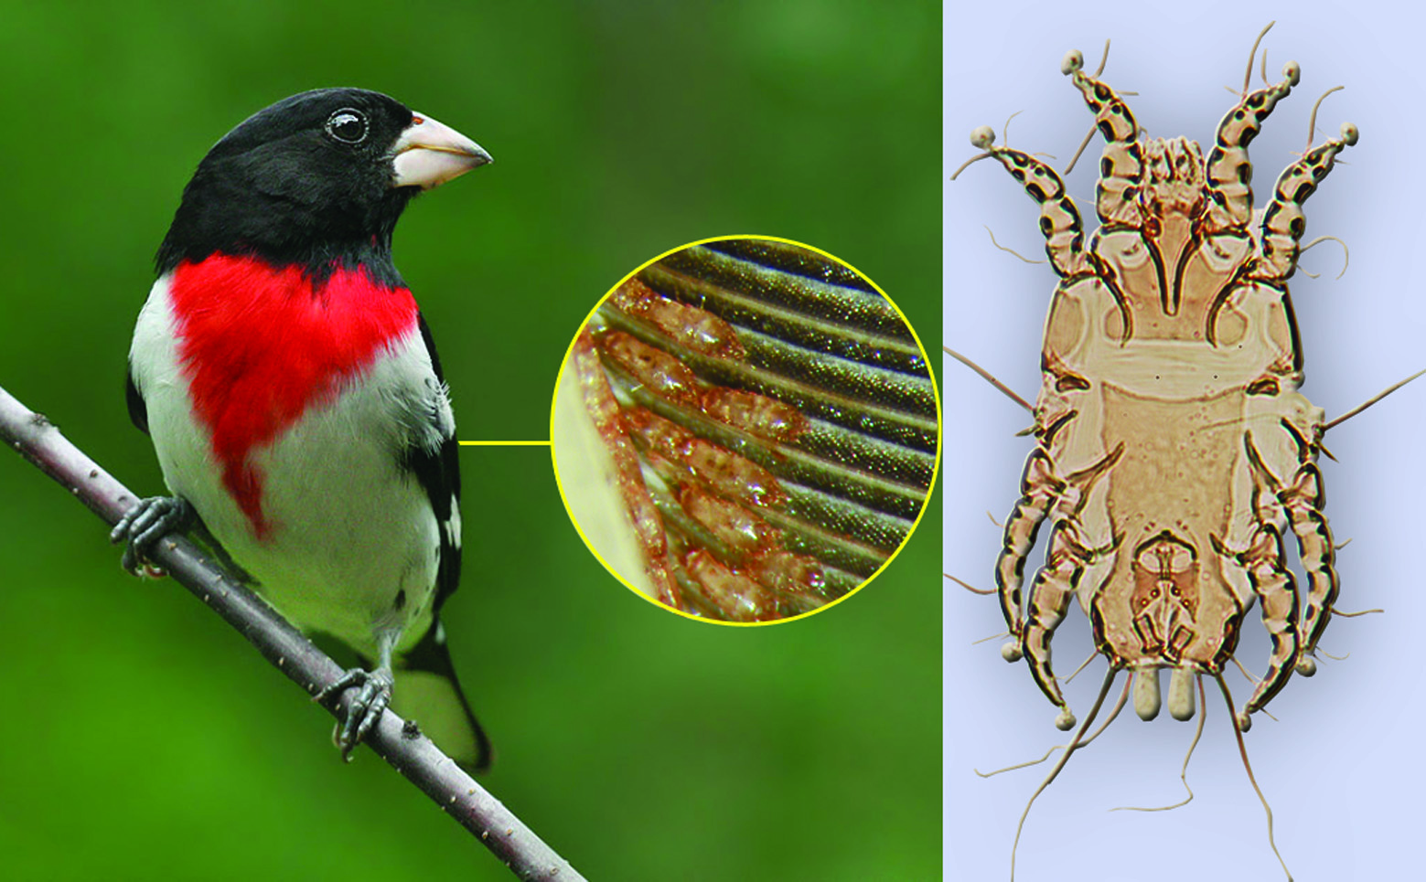
Feather mites
Feather mites can be found on the plumage of virtually every bird. Sometimes there are several species in different areas of the host body. Many feather mites exhibit strict coevolution with their hosts.
.
Proctophyllodes pheuctici
(Proctophyllodidae)
Pheucticus ludovicianus

Slide 12
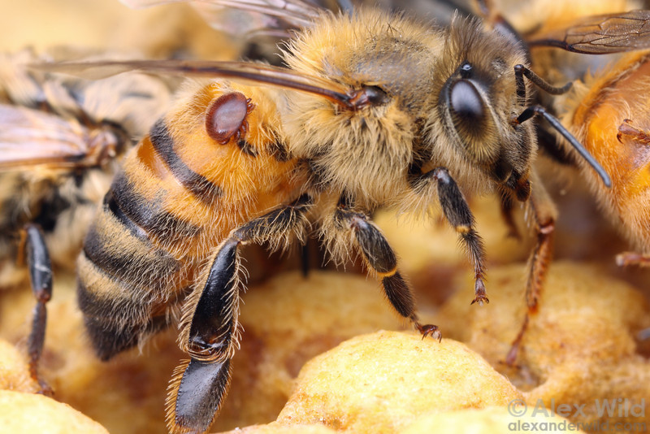
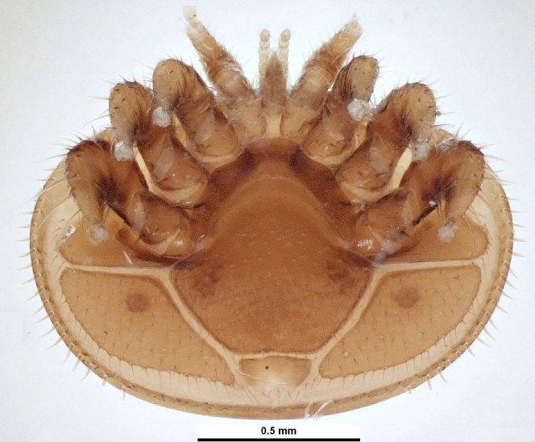
Bee-associated mites
Varroa destructor
Among bee mites, Varroa destructor, is a parasite of the European honey bee. It is responsible for the worldwide decline of populations of honeybees.

Slide 13
Island Biogeography: Predictions
Bee-associated mites
There are several hundred species of other bee mites. Chaetodactylus krombeini is cleptoparasite feeding on the bee larva food in the nest. Here the phoretic stage of this mite is shown.
Chaetodactylus krombeini

Slide 14
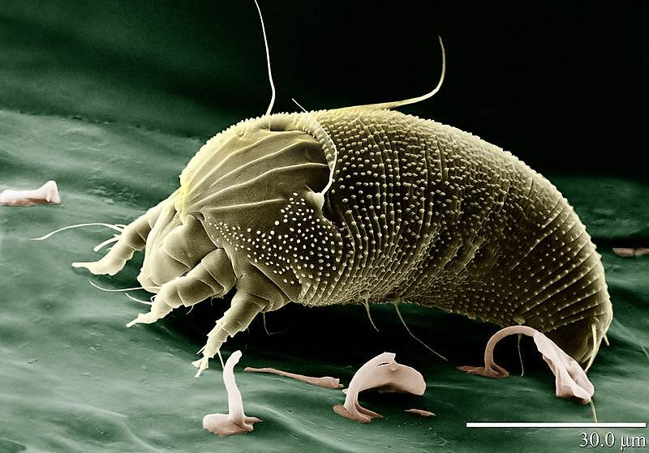
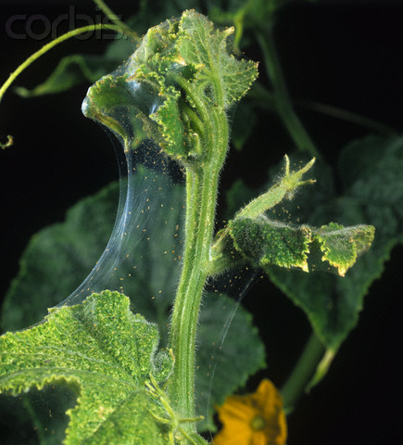
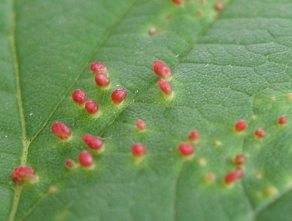
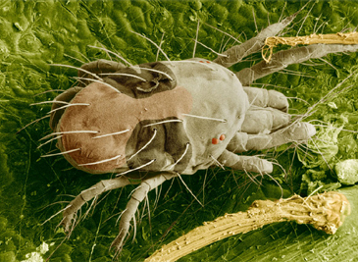
Plant mites
Aceria (gall mite)
Tetranychus (spider mite)
Gall mites initiate gall formation and other host abnormalities.
Spider mites may commonly be found associated with fine silk webbing
that they spin from large unicellular glands located in the palpi. They are found on virtually every major food crop and ornamental plant, often causing serious injury to, or death of, the host.

Slide 15
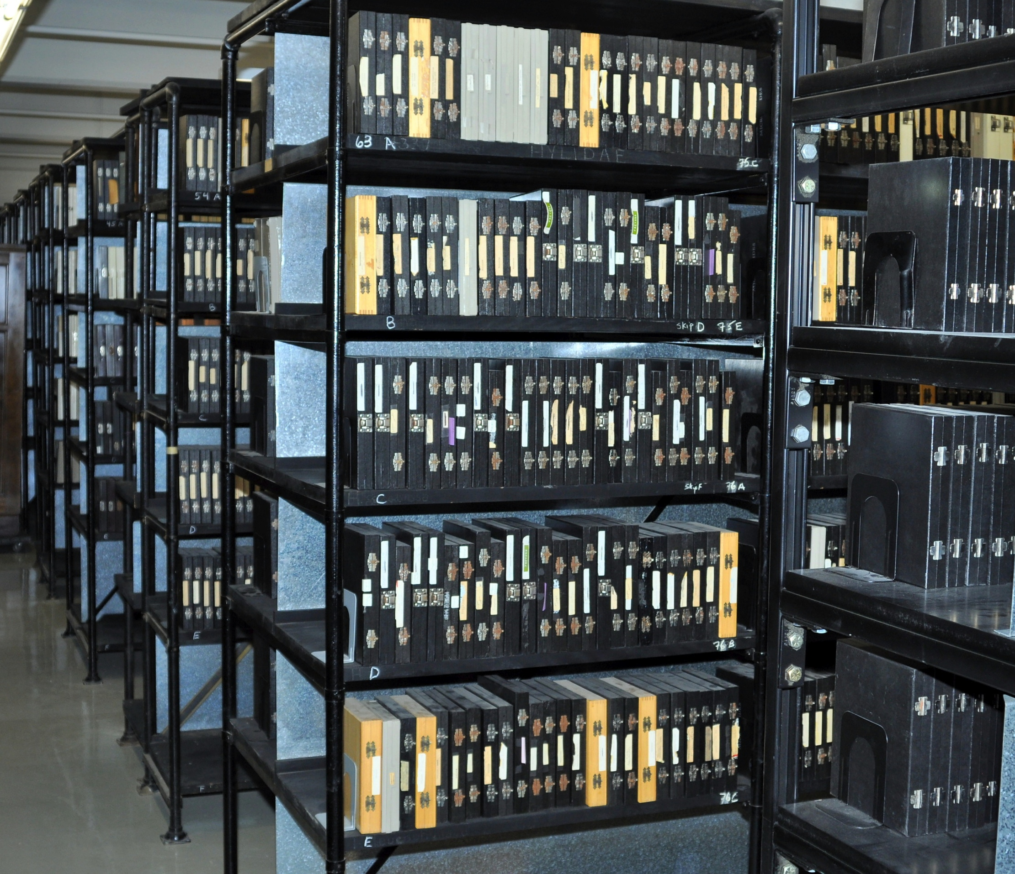

Slide Collection at UMMZ
Slide Collection at UMMZ
One of the largest in the world: 400,000 slide-mounted mites.
Strength in parasitic mites and free-living Astigmata.
Incorporates materials from several acarologists worked at different times in the USA.
Many slides are identified by specialists working on a particular group.
Includes primary types
Maintained by Barry OConnor, the world renowned mite systematist.
.
One of the largest in the world: 400,000 slides mounted mites and 70,000 alcohol lots.
Strength in Astigmata, including parasites of mammals and birds and parasitic mites from other groups.
Incorporates materials from several acarologists worked at different times in the USA.
Many slides are identified by specialists working on a particular group.
Maintained by Barry OConnor, a world renowned mite systematist.
.

Slide 16
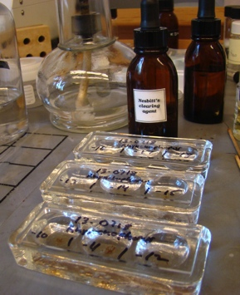
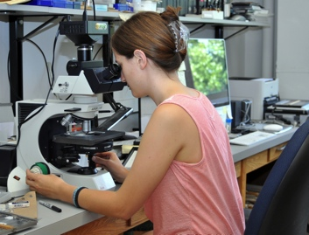
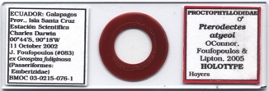
Workflow chart for microscopic specimen imaging
Before taking pictures, a specimen should be cleared and mounted on slide.
Then multiple pictures should be merged and further processed in Photoshop.
The final picture should be linked to its respective record in the database.
Clearing
Mounting
Photographing
Merging pictures into a single image
Adjusting color balance and contrast
Linking image to database record

Slide 17
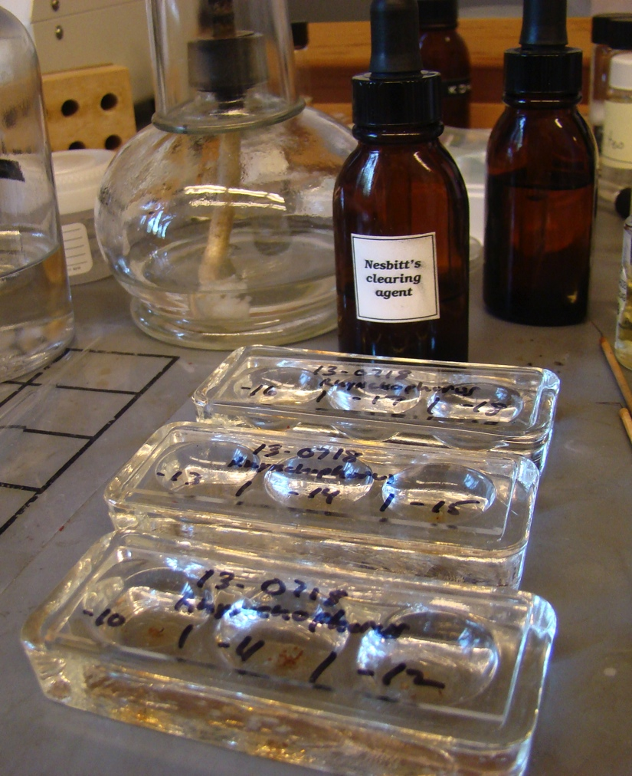
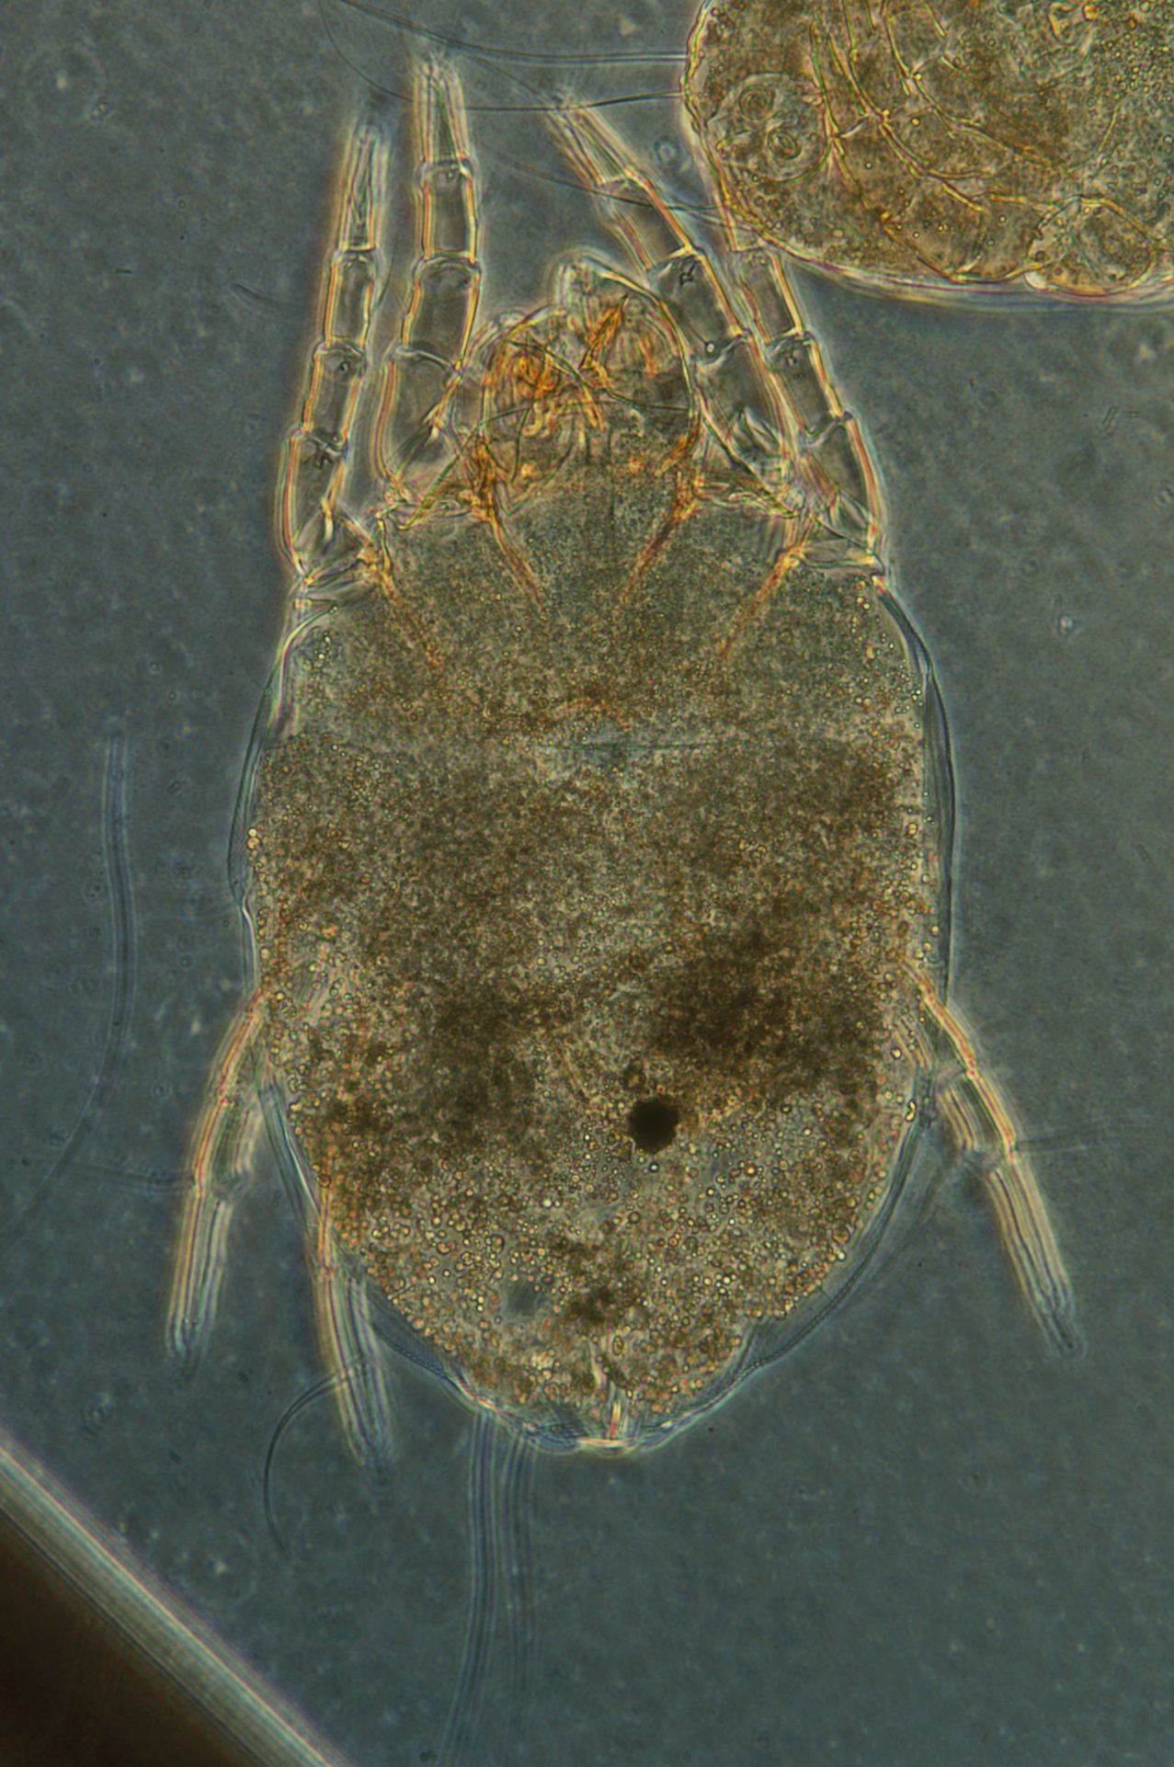

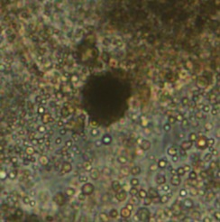
Specimen preparation
Clearing in Nesbitt’s fluid: 1-2 days at RT or heating at nearly boiling temperature for 2-3 mins
Before mounting specimen should be cleared to remove guanine crystals (metabolic products) and optically dense gut contents.
This screen shows the process of mite clearing using Nesbit fluid and 3-depression spot plates.
specimens are cleared in 3-depression spot plates using Nesbitt’s fluid
before
after
Gut contents
Guanine crystals

Slide 18
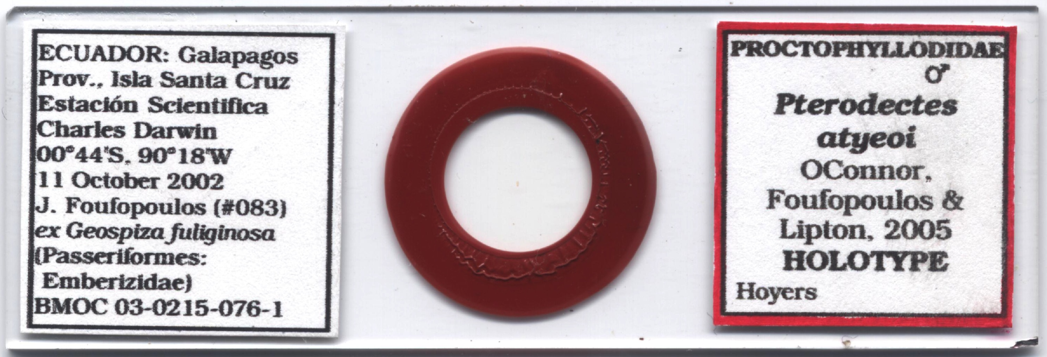
Specimen preparation: Microscopic slide
Collection locality and date
Id label (red border indicates a holotype)
locality label
insulating varnish (two layers)
Cover glass
family
Binomial name, author, and year
Each slide has two layers of insulating varnish, locality and id labels.
Sex/stage
mite specimen (in Hoyes medium)
medium
type [if any]
Collector and collector number
host
slide
BMOC number (unique lot id)

Slide 19
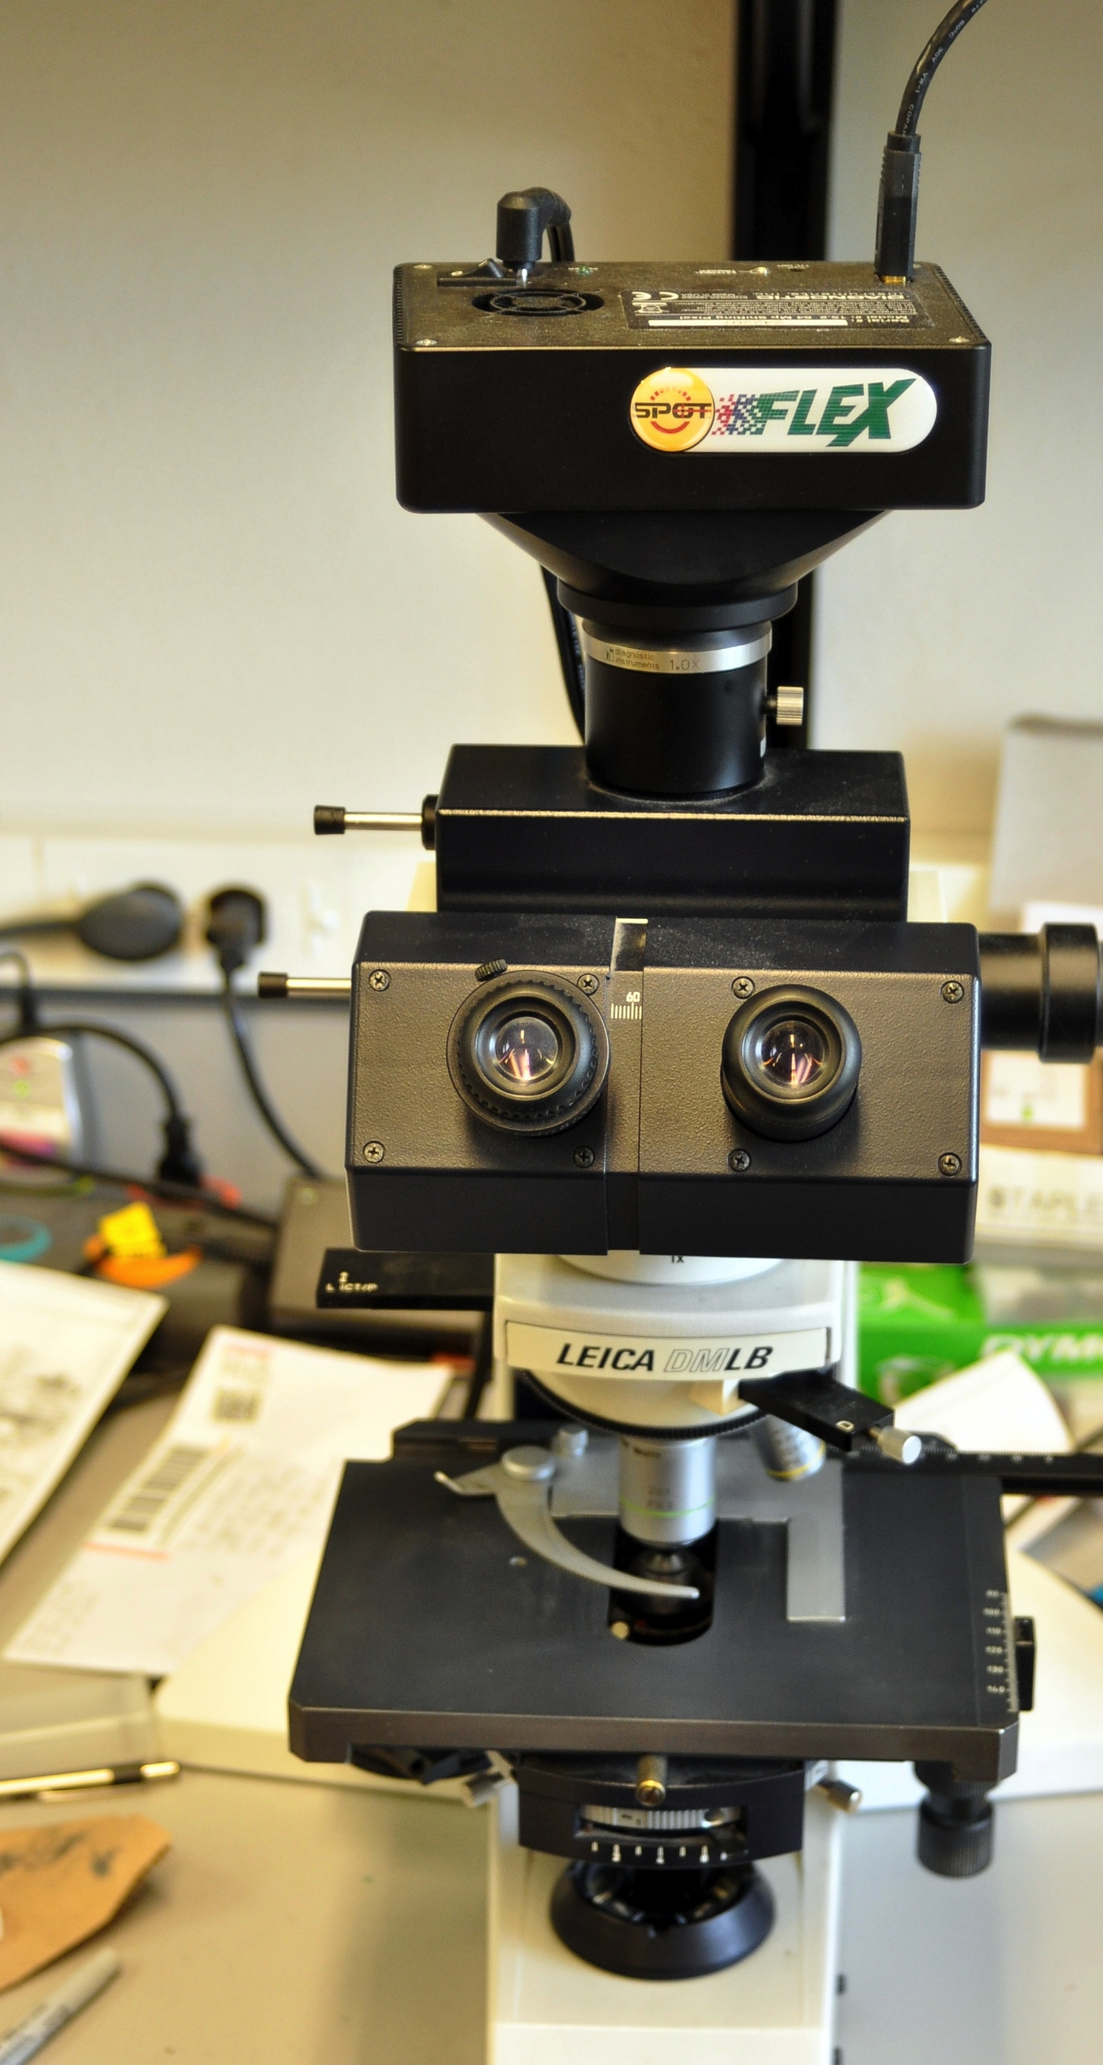
Camera
SPOT Flex Digital Camera
4.0 megapixel CCD
4-shot full color sampling
up to 64 megapixel resolution with pixel shifting technology
Peltier cooling (–20°C)
FireWire 1394a connection
high-resolution preview on a computer monitor

Slide 20
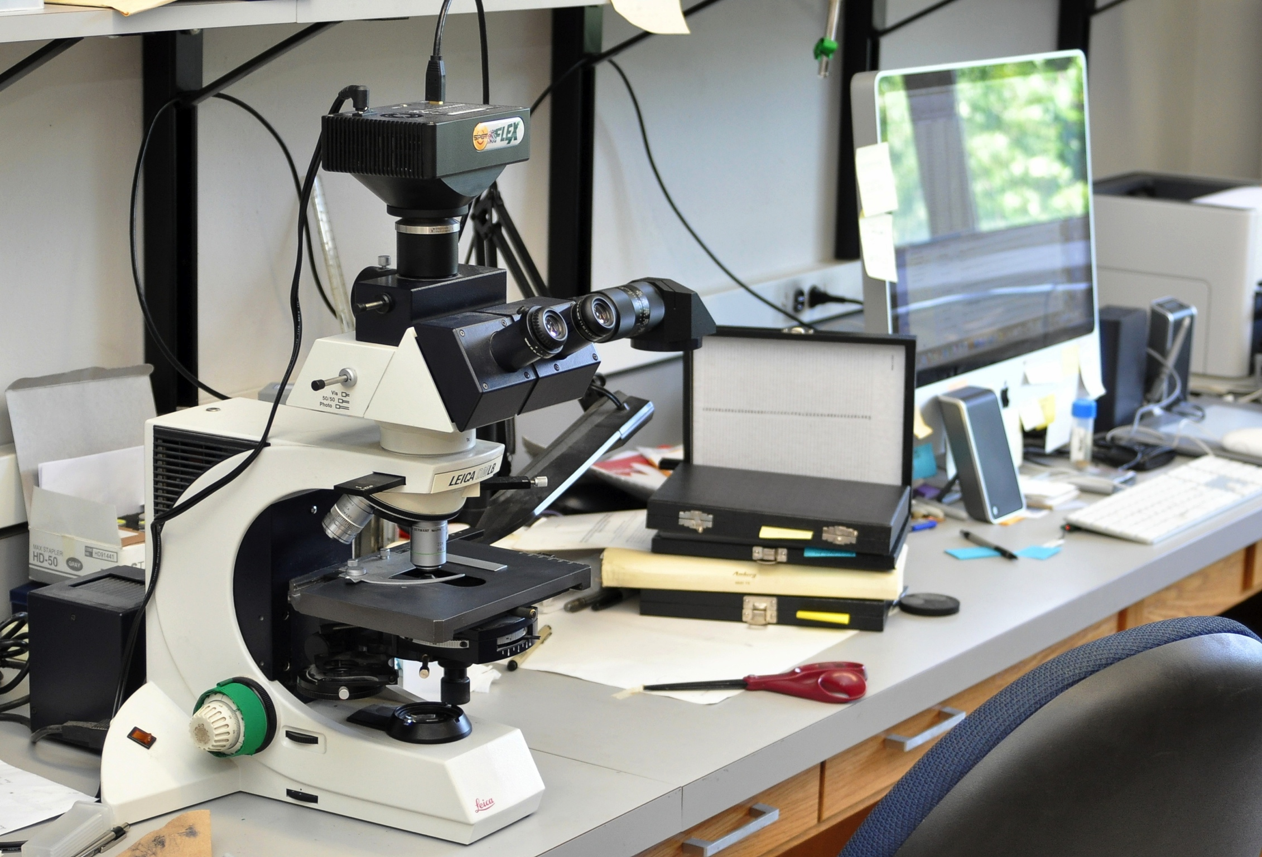
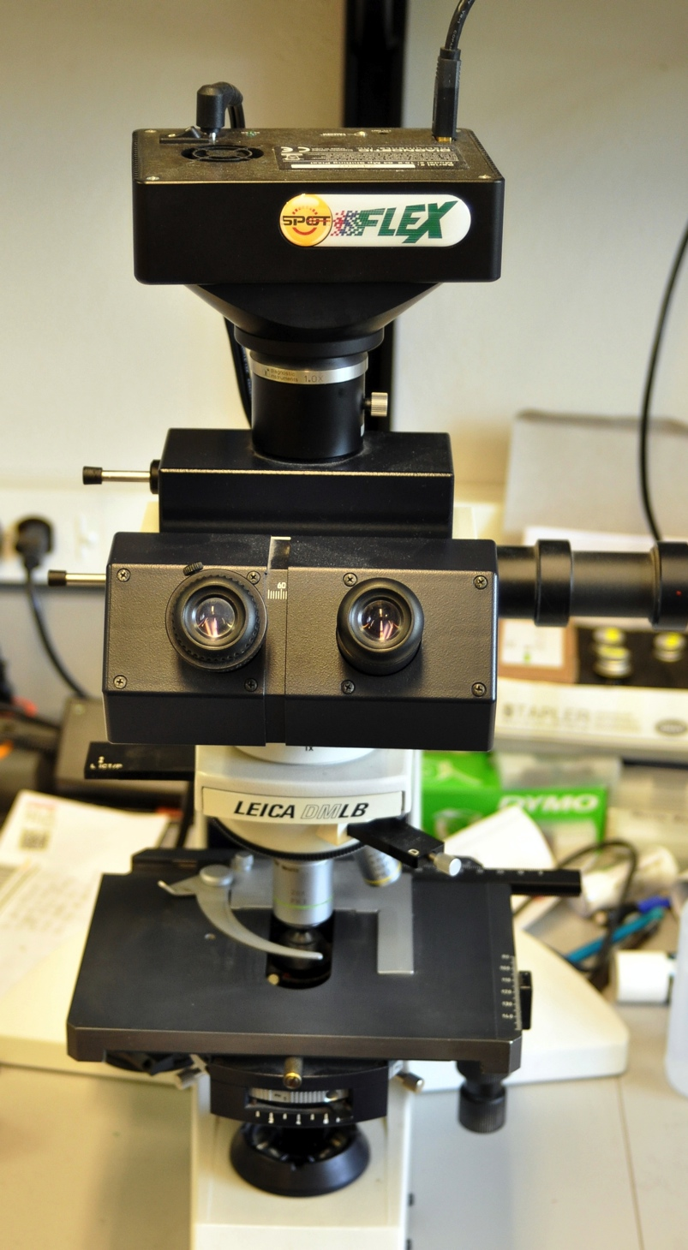
Light Microscopy Set Up
Thou shalt not make a mess on thy desk!
Spot digital camera connected to a computer
Leica microscope with Phase Contrast and DIC

Slide 21
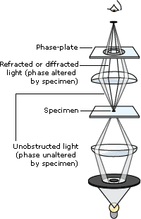
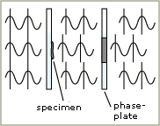
Phase Contrast Microscopy
Useful for transparent specimens (refractive index similar to that of the medium)
In phase-contrast microscopy, the phase plate increases the phase difference to half a wavelength. Destructive interference between the two sorts of light when the image is projected results in the specimen appearing as a dark object.
Destructive inference causes
the specimen to appear as dark object
Phase-plate changes phase difference to half of a wavelength

Slide 22
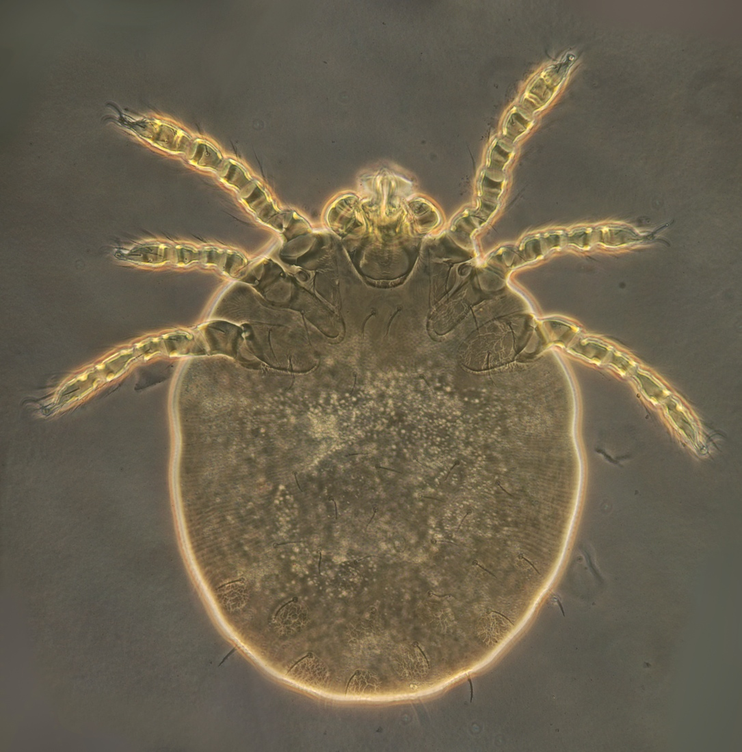
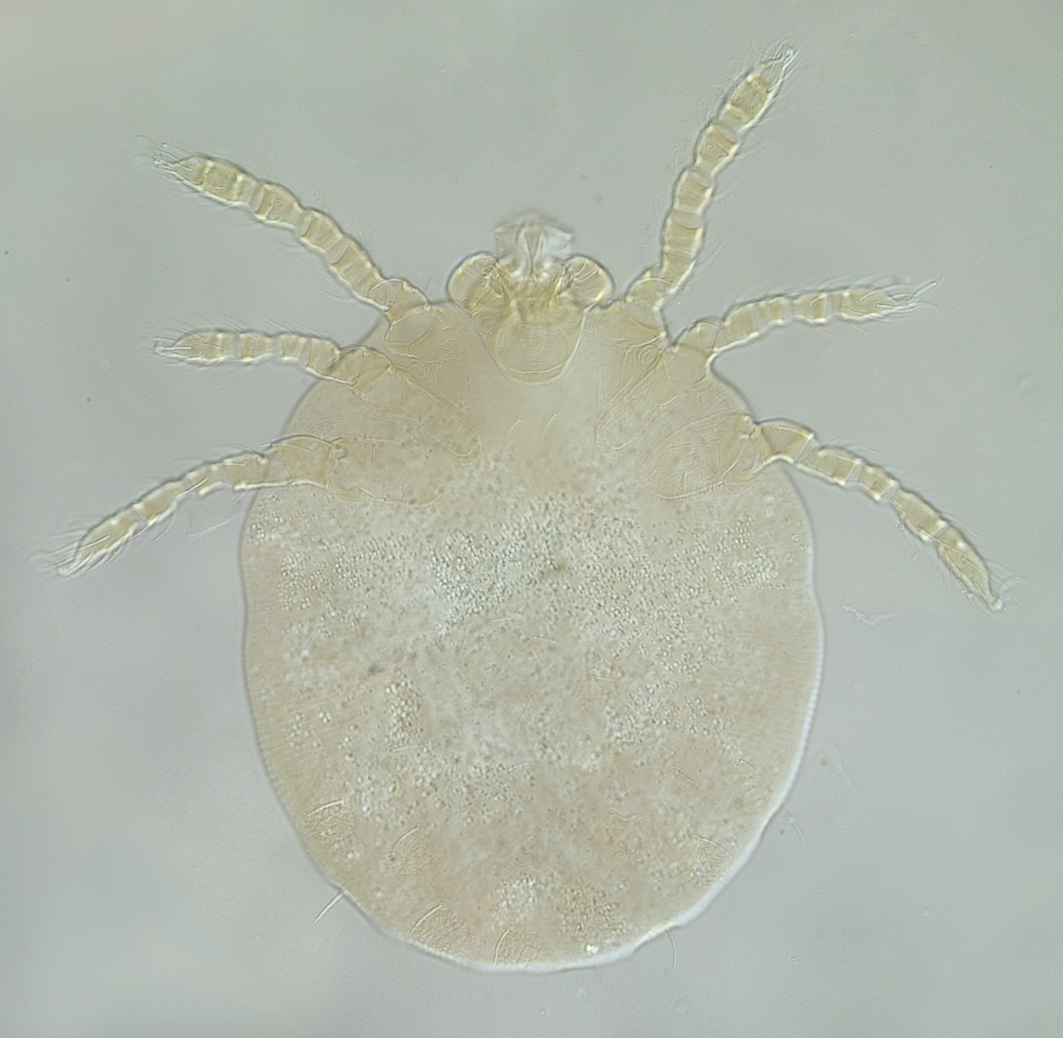
Phase Contrast Microscopy
Phase contrast
No phase contrast
Gahrliepia parmulaseta (chigger)
Phase contrast makes a transparent specimen to shine out in contrast to the background

Slide 23
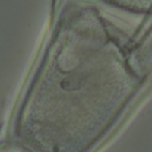
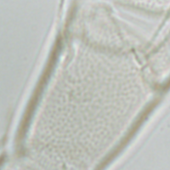
Phase Contrast Microscopy
Sensory organ (ereynetal organ) on tibia I of Riccardoella triodopsis
Phase contrast
No phase contrast
Phase contrast makes the edges of transparent structures better visible

Slide 24
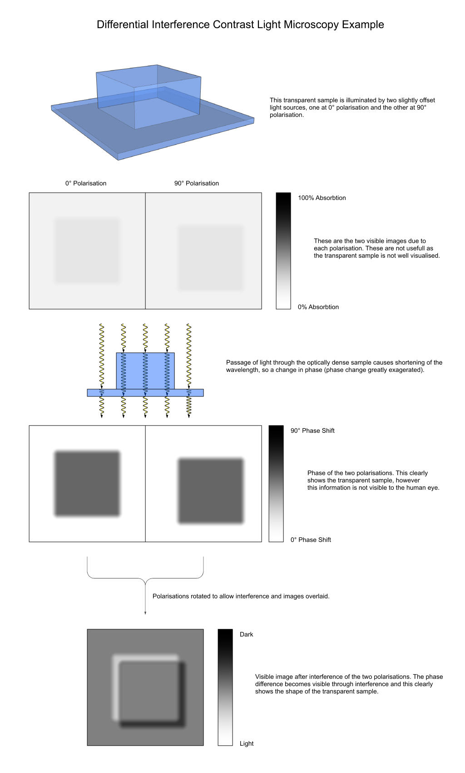
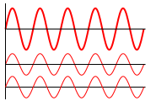
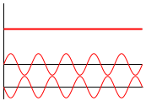
Differential Interference Contrast Microscopy (DIC)
1) Sample is illuminated by two sources of polarized light at 0° and 90° (perpendicular). The sources are offset 0.2 μm apart
2) A prism recombines the two perpendicular polarized rays into the same polarization (at 135°). The combination of the rays leads to interference - brightening or darkening of the image.
brighter
A DIC image creates an impression of a 3D-object
darker

Slide 25
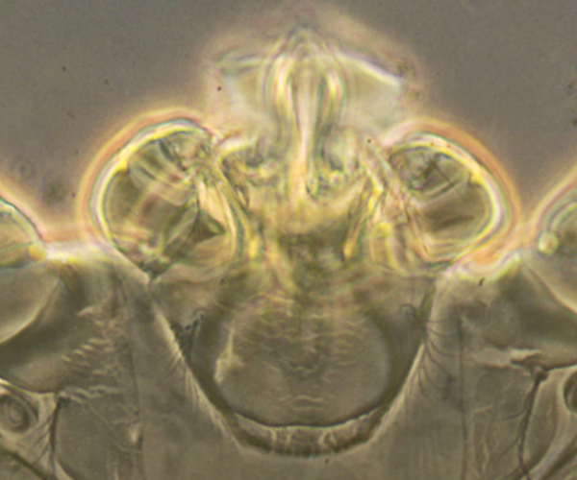
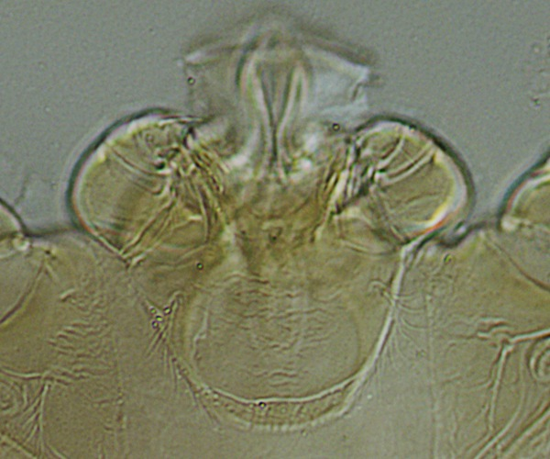
Phase Contrast vs DIC
Phase contrast
DIC
poorly visible
better visible
dark
halo
Phase contrast diffraction halo outside the plane of focus may obstruct the view of complex multidimensional objects and and make some object difficult to see.
contrasts
with
background
Blends with
background
bright
Palps of the chigger Gahrliepia parmulaseta
1) Diffraction halo outside the plane of focus (may confuse the view of some structures) | 2) No halo
2) Density represented as darkening | 2) Density represented as darkening and brightening (false 3D image) (bright areas may blend with the background)

Slide 26
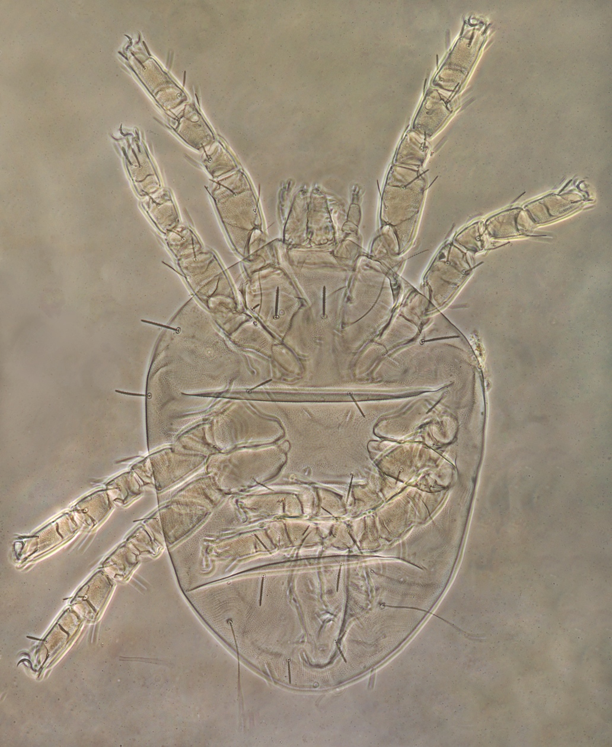
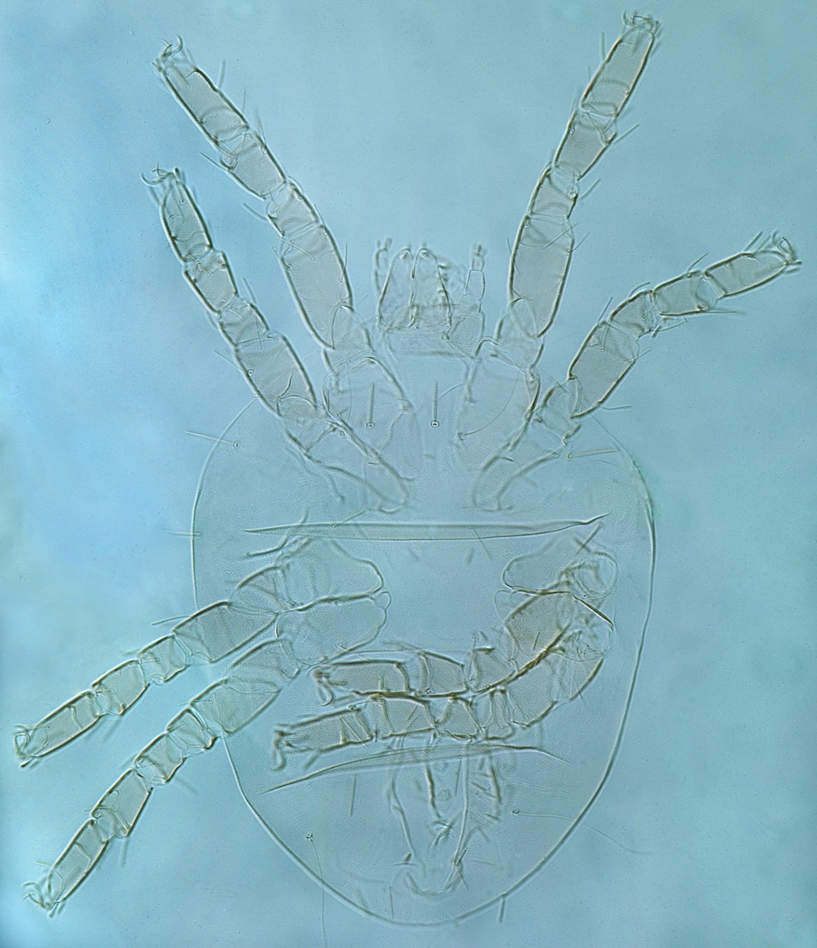
Phase Contrast vs DIC
Phase contrast
DIC
Setae better visible
Riccardoella triodopsis
Generally, for very transparent specimens, phase contrast gives more details. It is preferred here.

Slide 27

Phase Contrast vs DIC
Phase contrast
DIC
Too much clutter
No clutter
Riccardoella triodopsis
Caraboacarus calosomae
For less transparent specimens, phase contrast may create too much visual clutter. DIC is preferred here

Slide 28


Phase Contrast vs DIC
Phase contrast
DIC
phase halo (details difficult to see here )
no halo (more details visible)
Thin setae blended with background
Thin setae contrast with background
Thin setae contrast with background
Thin setae blended with background
Riccardoella triodopsis
Metabinuncus obscuris
If a specimen exhibits heterogeneous areas then taking both phase contrast and DIC pictures is preferred

Slide 29

Processing images in Photoshop
If a specimen does not fit to the camera’s field of view, then several pictures can be made and then combined using a computer. This technique also provides greater level of details in the combined picture. This short video will walk you through the process of merging microscopic images into a single picture.

Slide 30
Databasing
mites
The next step is to disseminate images over the internet. We use FileMaker and php for this purpose. Images are linked to their respective database records by their unique BMOC numbers.
Database records and images are linked by a unique identifier (BMOC number)

Slide 31
Bee-Associated Mite Web Site: species pages
Images are also incorporated to our website featuring species pages for bee mite species.

Slide 32
Bee-Associated Mite Web
integration with biodiversity portals
Bee-Associated Mite Site
Finally, we have integrated our web pages with external biodiversity educational portals. For example, our site provides data (almost in real time) to the Encyclopedia of Life website. Once the content of our site changes the change will immediately reflected on the EOL site. To communicate with the EOL, our site uses is structured using xml and common ontologies, so the EOL site can understand this information. Then a php code sends this structured information to the EOL.
EOL (Encyclopedia of Life) site
1) Data are are structured using xml and common ontologies. Now both our site and EOL talk in ‘the same language’.
2) A php code validates the xml and sends this information to the EOL server

Slide 33



Time in the theory of relativity
So many mites, so little time!
Acknowledgements
OConnor’s lab
Ria Wooten (pictures and patience)

Slide 34
Bee-Associated Mite Web: integration with database
Again, the webpages and the database are cross-linked, so it possible to obtain interactive distributional maps or record list with a single click of mouse.
This screen shows distribution of the main mite pest of orchard bees in the US.

Slide 35
Bee-Associated Mite Web: integration with database
This screen shows al available database records for the same mite species.

Slide 36

UMMZ slide collection
Eusocial (queen and workers)
Two types of workers
Feed on seeds or insects
~1100 spp worldwide
~272 spp in Melanesia
Many spp endemic
Some spp invasive and
widely distributed
Slides are stored in slide boxes, each is ringed with insulating varnish to prevent medium deterioration.
Insulating varnish
Because mounting medium may desiccate each slide is ringed with a insulating varnish.
Each slides has a locality label and unique lot number

Slide 37

Holotypes
Holotypes are kept separately from the main collection.

